Slide 1



Akinwumi Oluwatobi - Sprocket Dataset
View in Power BI
Last data refresh:
6/7/2025 5:21:59 PM UTC
Downloaded at:
6/7/2025 5:27:17 PM UTC

Slide 2
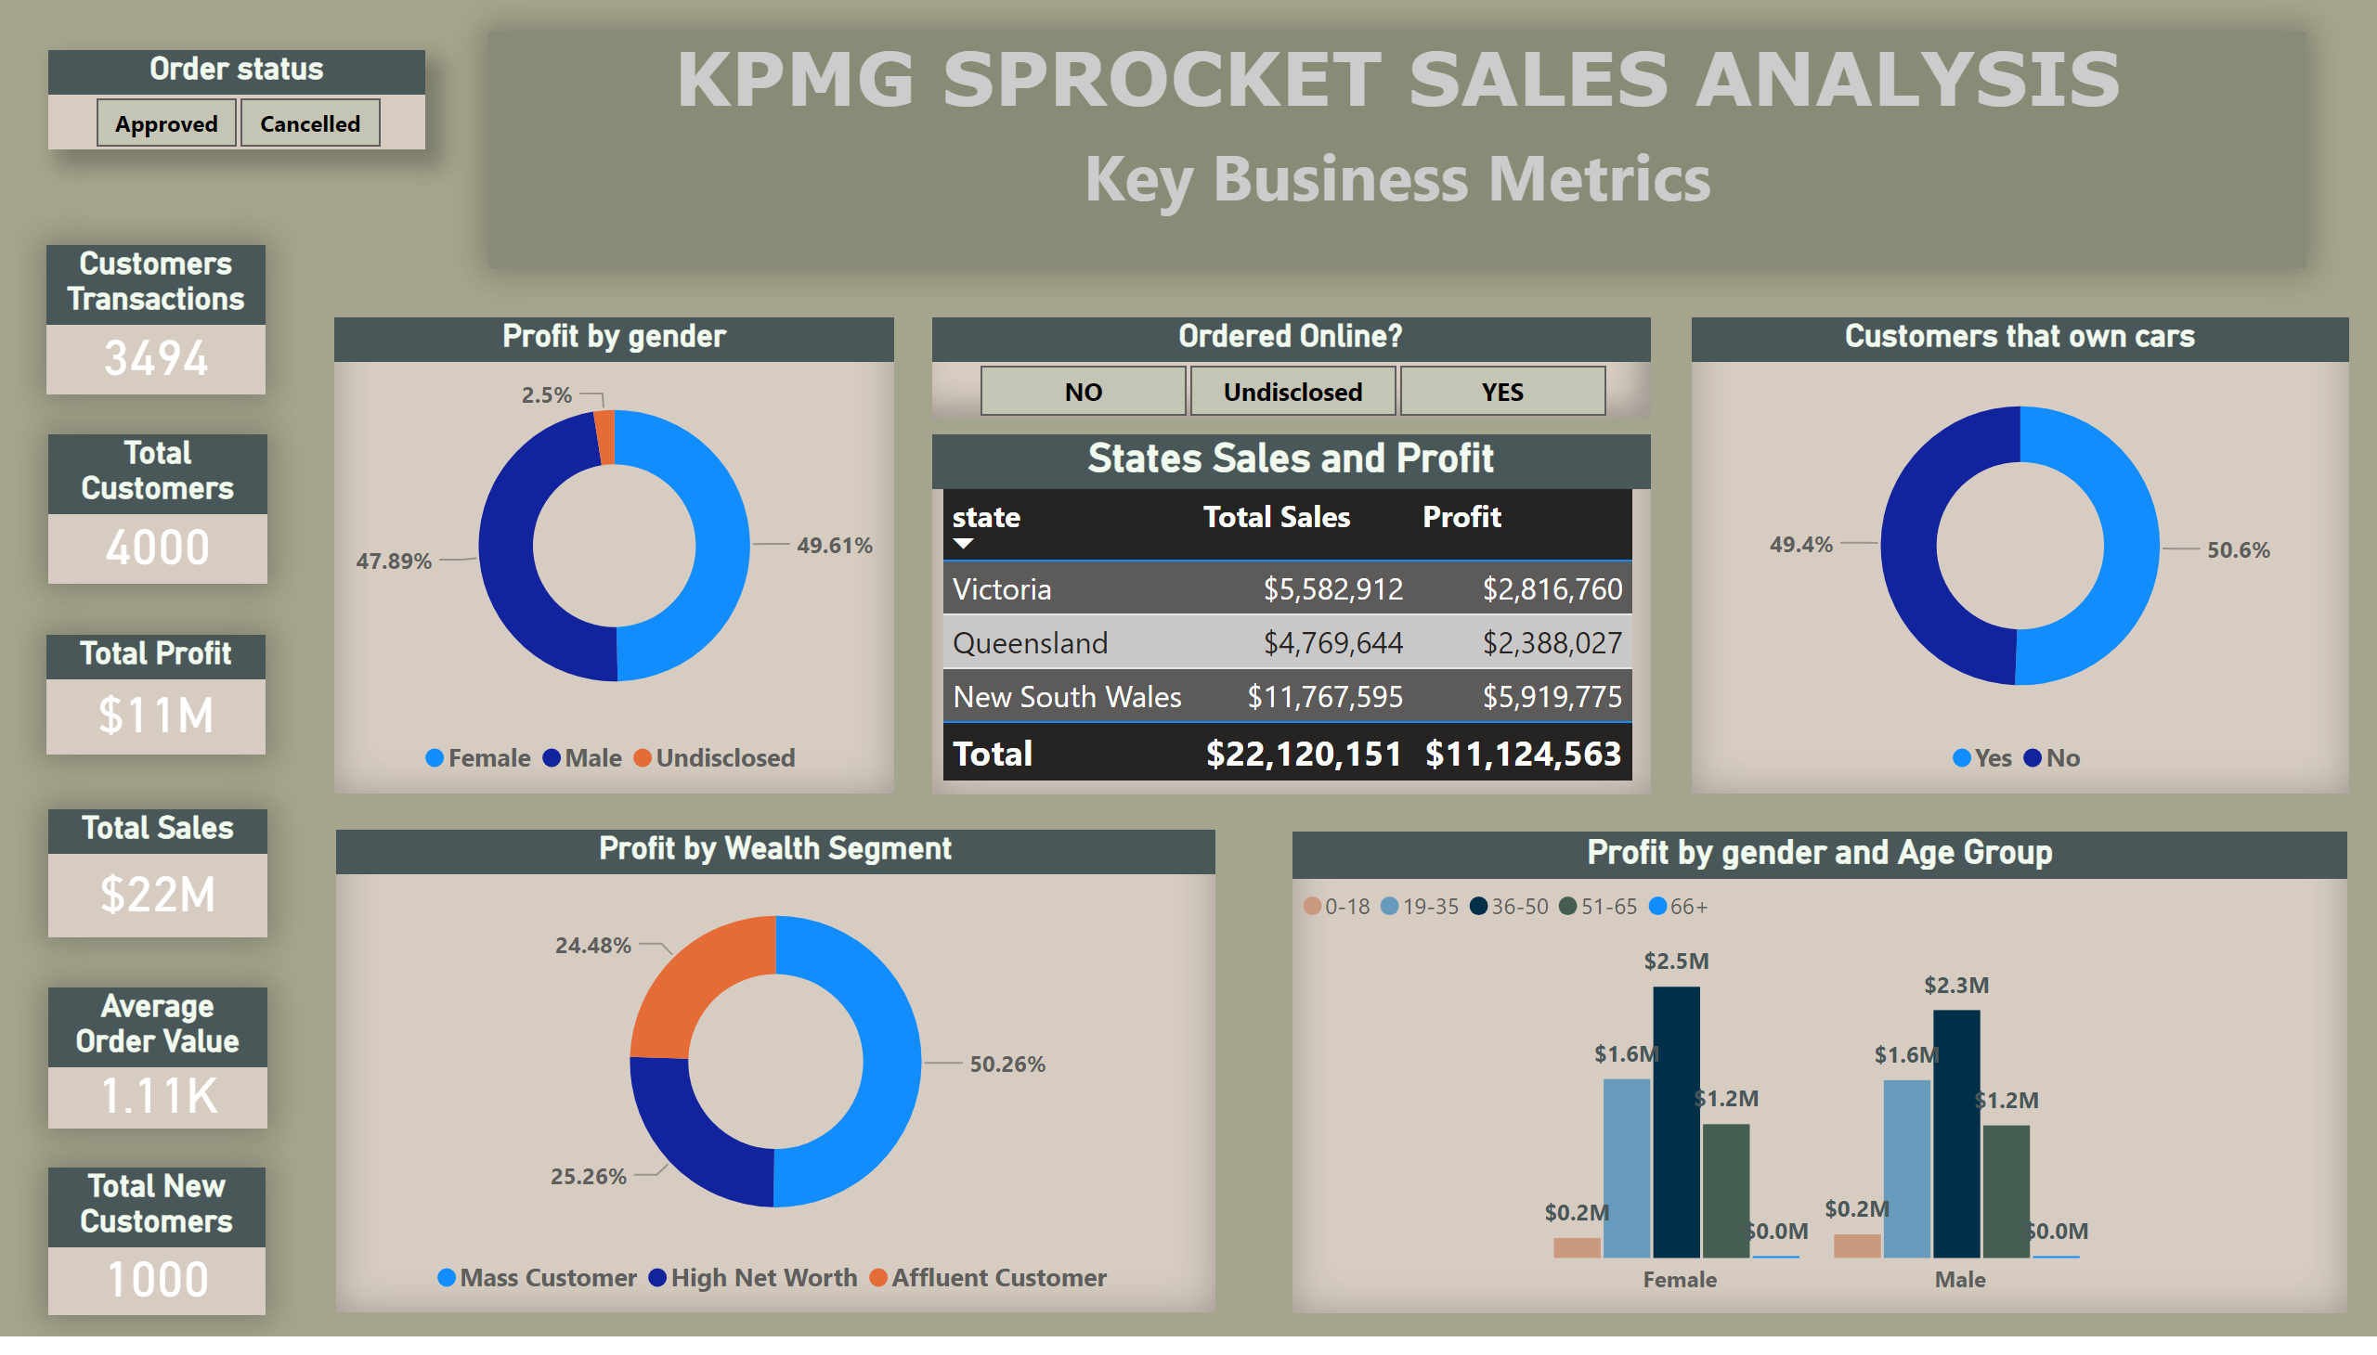
Page 1
Notes:
Profit by gender
No alt text provided
Profit by Wealth Segment
No alt text provided
States Sales and Profit
No alt text provided
Order status
No alt text provided
Ordered Online?
No alt text provided
Customers that own cars
No alt text provided
Total New Customers
No alt text provided
Average Order Value
No alt text provided
Total Sales
No alt text provided
Total Profit
No alt text provided
Total Customers
No alt text provided
Customers Transactions
No alt text provided
Profit by gender and Age Group
No alt text provided
KPMG SPROCKET SALES ANALYSIS
No alt text provided

Slide 3
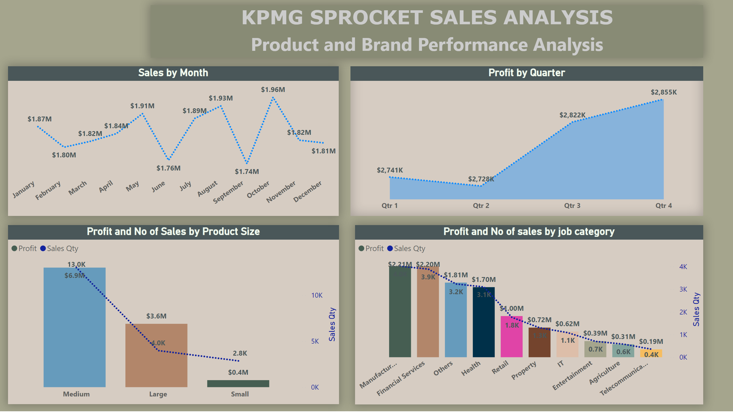
Page 2
Notes:
Profit and No of Sales by Product Size
No alt text provided
Profit and No of sales by job category
No alt text provided
stackedAreaChart
No alt text provided
Sales by Month
No alt text provided
KPMG SPROCKET SALES ANALYSIS
No alt text provided

Slide 4
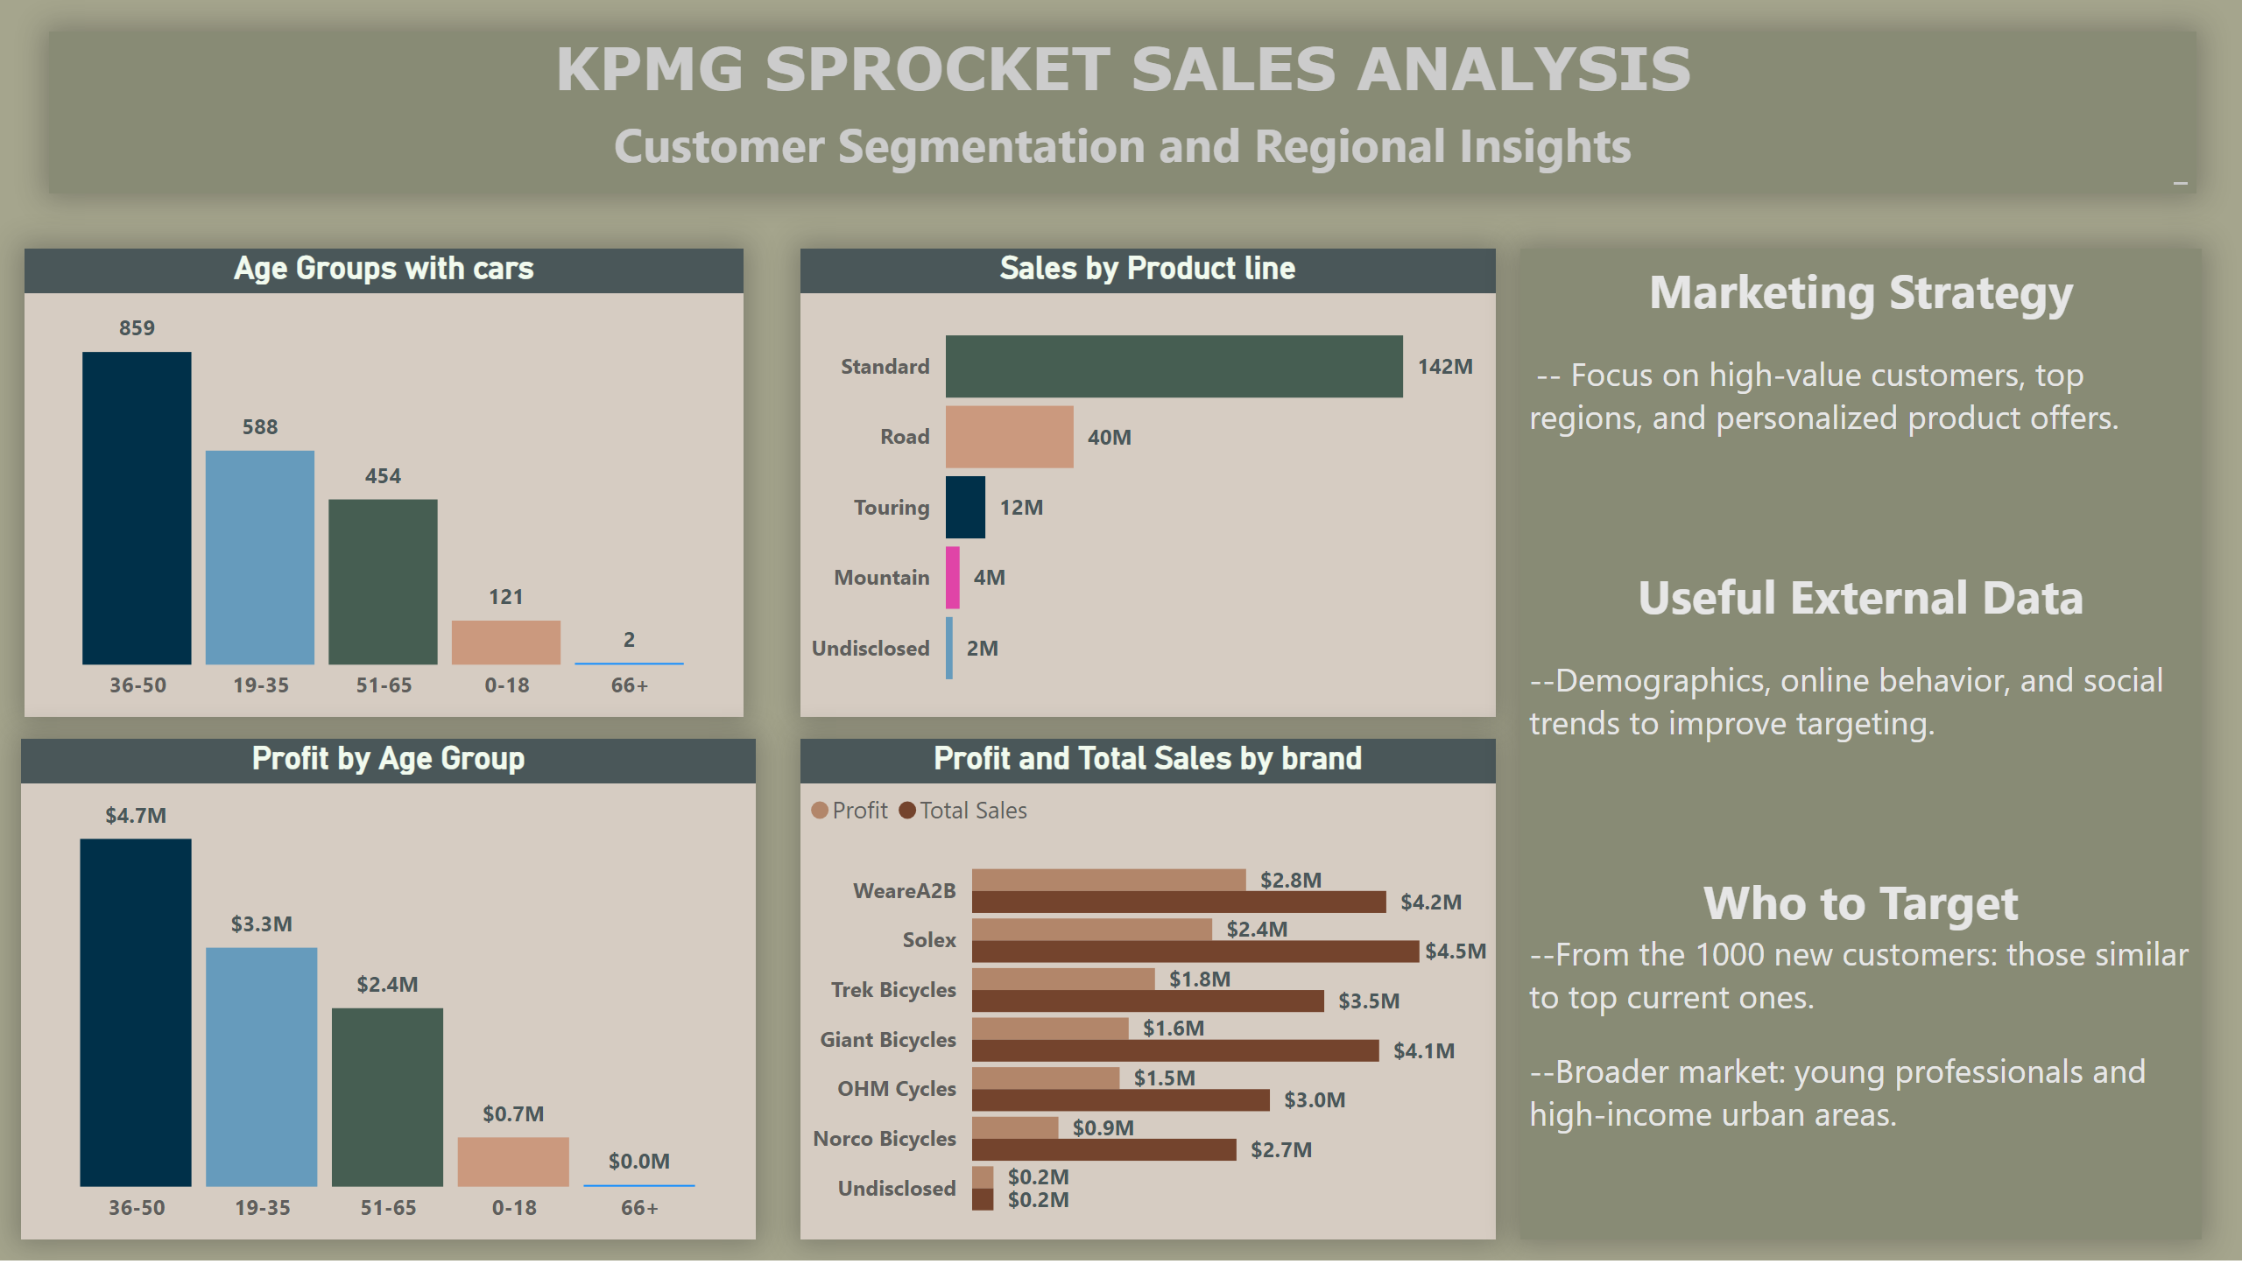
Page 3
Notes:
Age Groups with cars
No alt text provided
columnChart
No alt text provided
Sales by Product line
No alt text provided
clusteredBarChart
No alt text provided
KPMG SPROCKET SALES ANALYSIS
No alt text provided
KPMG SPROCKET SALES ANALYSIS
No alt text provided

